Slide 1
Social Media and the Revolution in Egypt
Maksim Tsvetovat

Slide 2


Collaboration

Slide 3


Slide 4
“A good psychological warfare executive is no different from a market research executive, except that the PSYOP officer also likes to jump out of planes.”
Colonel Layton Dunbar, Commander
4th Psychological Operations Group
Operation Desert Storm

Slide 5
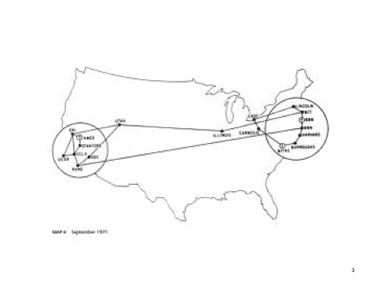

Slide 6
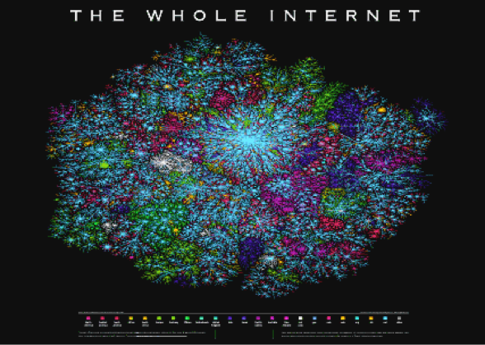

Slide 7
Internet more ubiquitous then electricity
87% of world population are within reach of a cell phone tower (and GPRS/3G internet)
80% of world population have some form of electricity accessible

Slide 8
Ubiquitous Social Media
Twitter has very low barriers to entry
Fast information propagation
Fluid communities
Largely decentralized
Works on every device including old cell phones (via SMS)

Slide 9
Freewheeling Media
No established channels or pages
#hashtags used to organize information -- but are voluntary and freeform
RT @attag: retweet -- spreads messages while keeping attribution

Slide 10
Information Cascades
Information can cascade through retweets, and grow exponentially

Slide 11
Some Statistics
Number of followers on Twitter is power-law distributed
Size of information cascades is power-law distributed (most go nowhere)

Slide 12
Result....
A social media outlet that is accessible and completely uncontrollable by authorities.

Slide 13
...only a matter of time...

Slide 14
Moldova, 2009

Slide 16
First Twitter Revolution...
Protests organized using #pman hashtag
Leaderless, real-time, free-form
Up to 10,000 people on the streets of Cisenau
100,000s participating online
Results in resignation of president and parliament and new elections

Slide 17
Lesson learned...
Being in the right place, in the right time, and somewhat well-connected beats careful planning

Slide 18
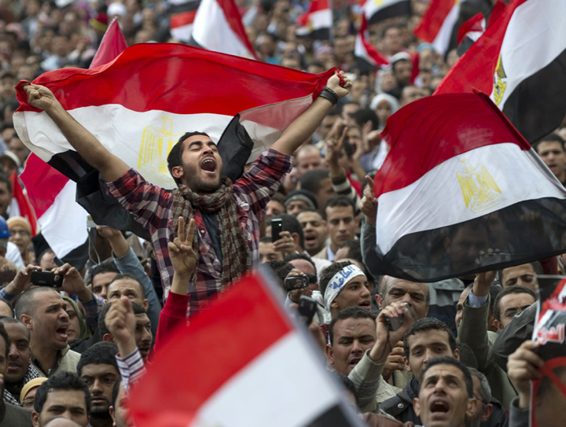

Slide 19
We were in the right place, in the right time

Slide 20
Captured Data
Analyzed 25,000,000 relevant tweets over one week
Identified communities, sub-communities and mass influencers related to events in Egypt
Analyzed “who” actively influenced discussions causing messages to cascade – or go viral
Correlated activity to events in the physical (offline) world
Highlighted profiles of mass influencers who demonstrated that when they spoke, other people reacted.
13

Slide 21
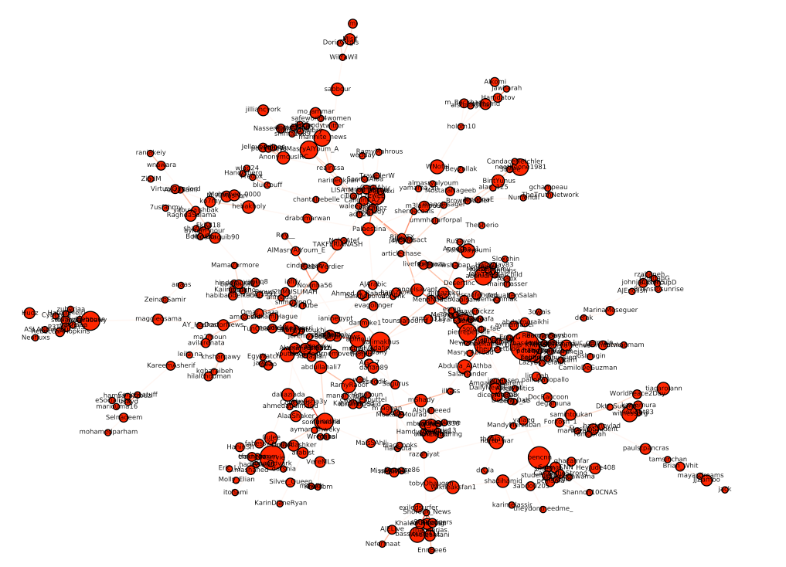
Going Viral – Influence in Action
The larger the node, the greater the reaction to messages
These people influenced action – they spoke, people acted
14

Slide 22
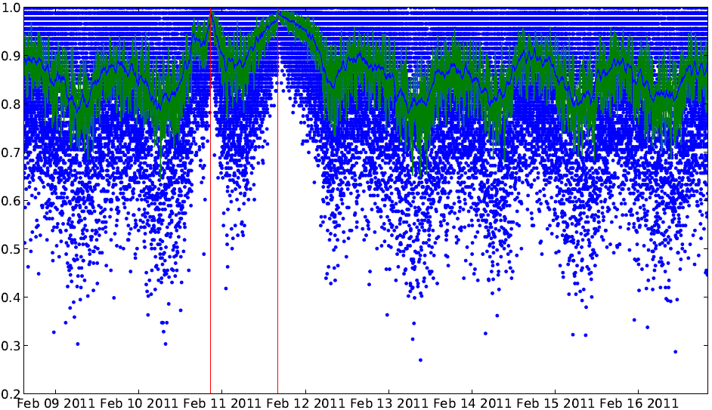
Online Activity vs World Events
UNCLASSIFIED
Tracked reaction online to events as they happened in the “real” world
Correlated VOLUME TIME OF DAY / WEEK / MONTH
Mubarak Resigns
Mubarqk speech – doesn’t resign
Daily Cycle
15

Slide 23
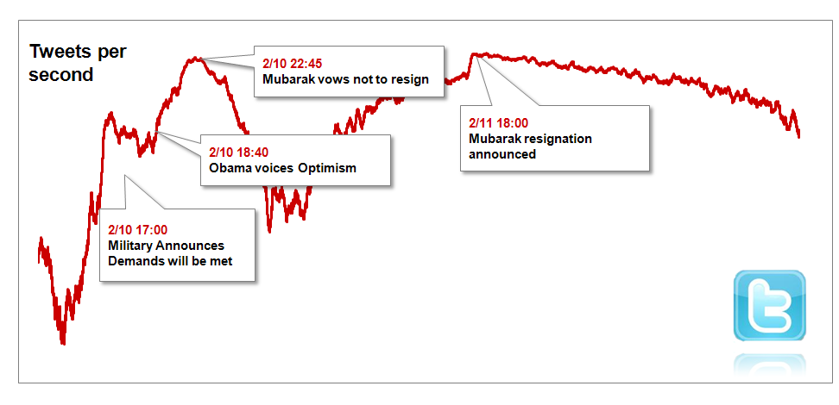
Online Activity vs World Events
UNCLASSIFIED
Correlated VOLUME SPECIFIC EVENTS
UNCLASSIFIED
16

Slide 24
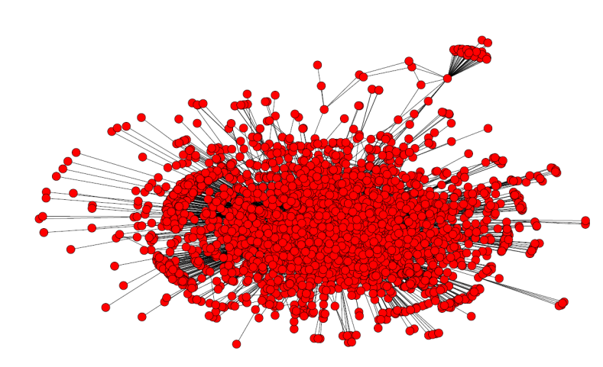
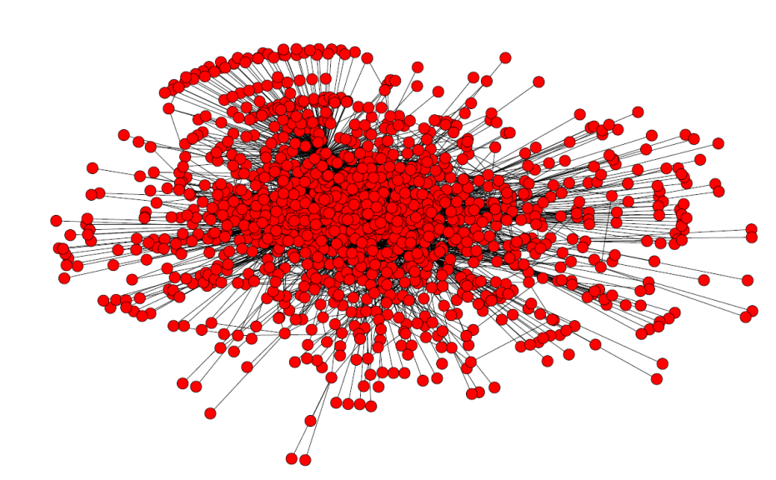
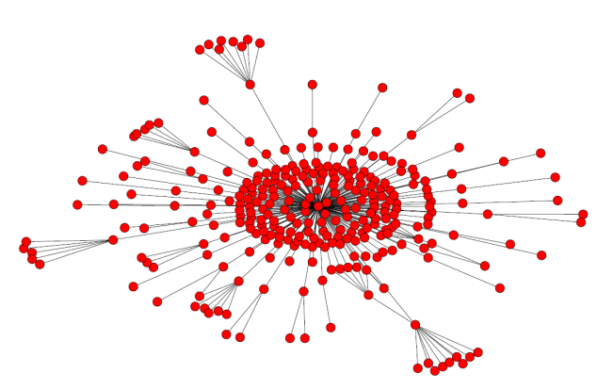
Most Influential vs Most Followed
Wael Ghonim
Twitter Followers: 86,000+
Reactions Generated: 3,291
Reactions per 1K followers: 38
MASS INFLUENCER
@Weddady – Mass Influencer
Twitter Followers: 6,900+
Reactions Generated: 1,281
Reactions per 1K followers: 186
Justin Bieber
Twitter Followers: 7.4 Million
Reactions Generated: 294
Reactions per 1K followers: 0.04
17

Slide 25
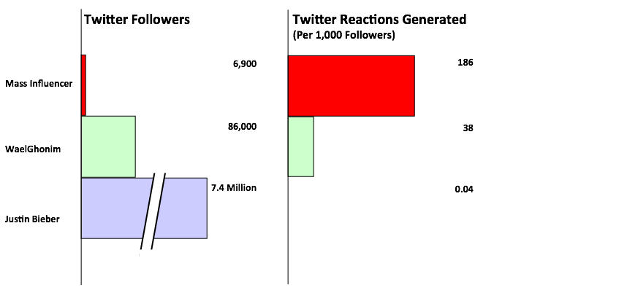
Most Influential vs Most Followed
18

Slide 26
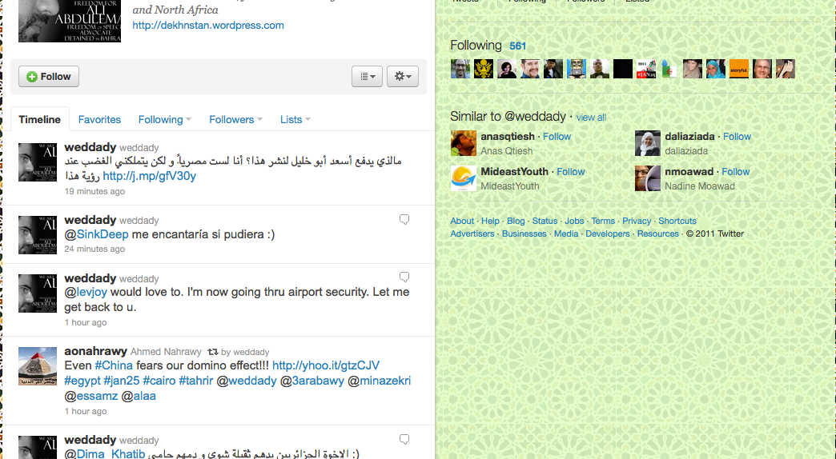
weddady
UNCLASSIFIED
Twitter Followers: 5,500
Reactions Generated: 1,808
Reactions per 1K followers: 186
UNCLASSIFIED
19

Slide 27
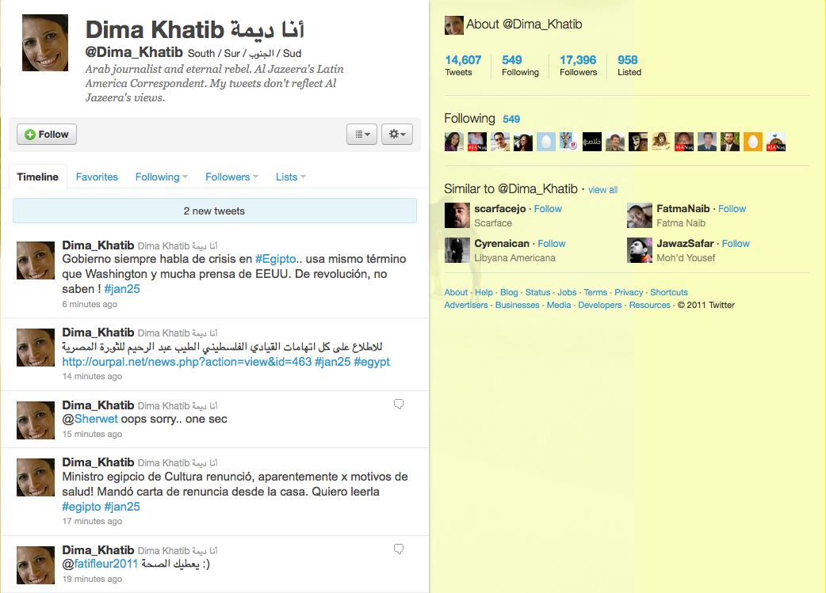
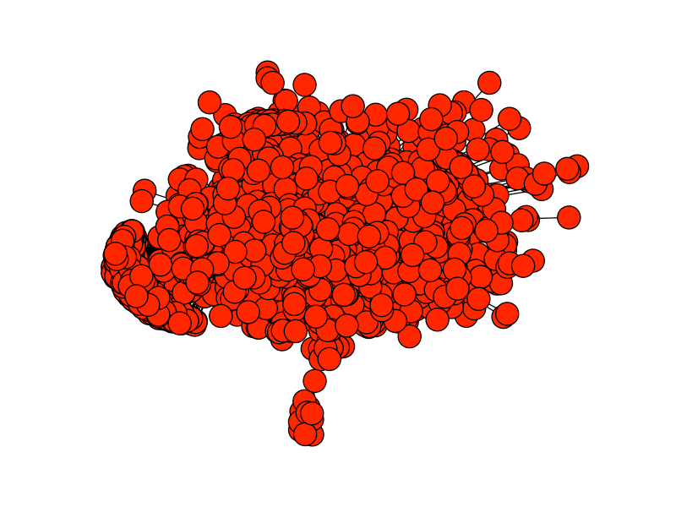
DimaKhatib
UNCLASSIFIED
Twitter Followers: 17,396
Reactions Generated: 1,694
Reactions per 1K followers: 97
20

Slide 28
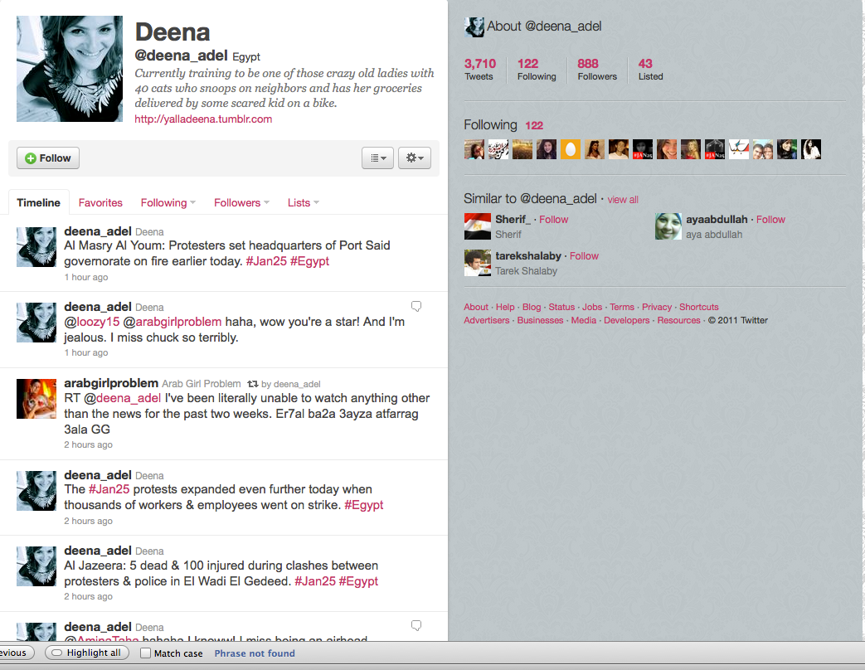
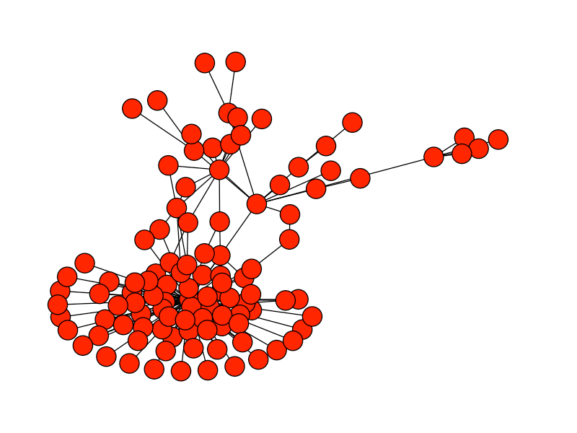
Deena
UNCLASSIFIED
Twitter Followers: 888
Reactions Generated: 108
Reactions per 1K followers: 122
UNCLASSIFIED
21

Slide 29
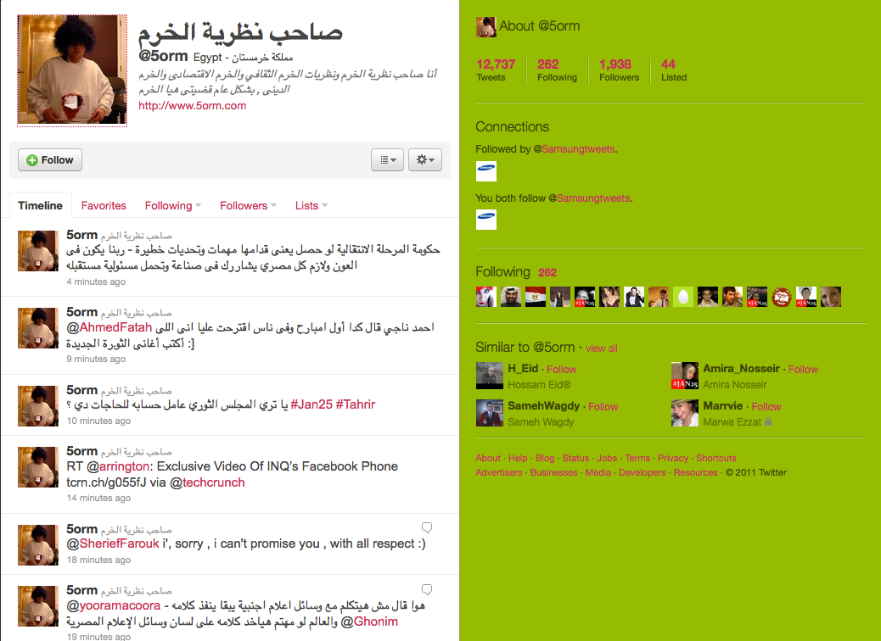
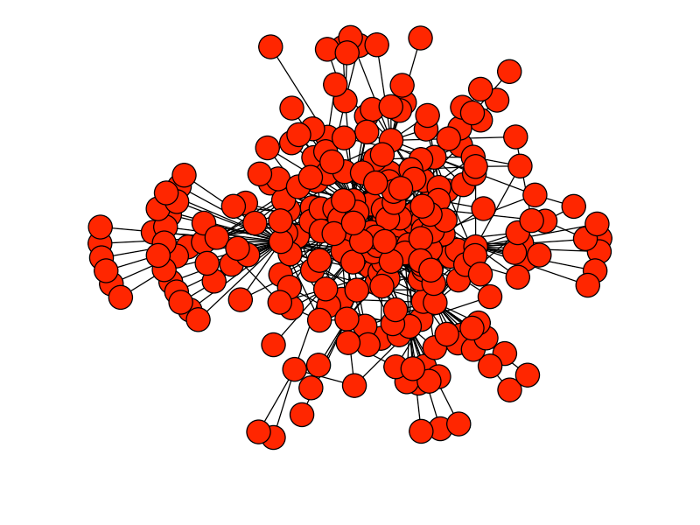
@5orm
UNCLASSIFIED
Twitter Followers: 1,938
Reactions Generated: 256
Reactions per 1K followers: 132
UNCLASSIFIED
22

Slide 30
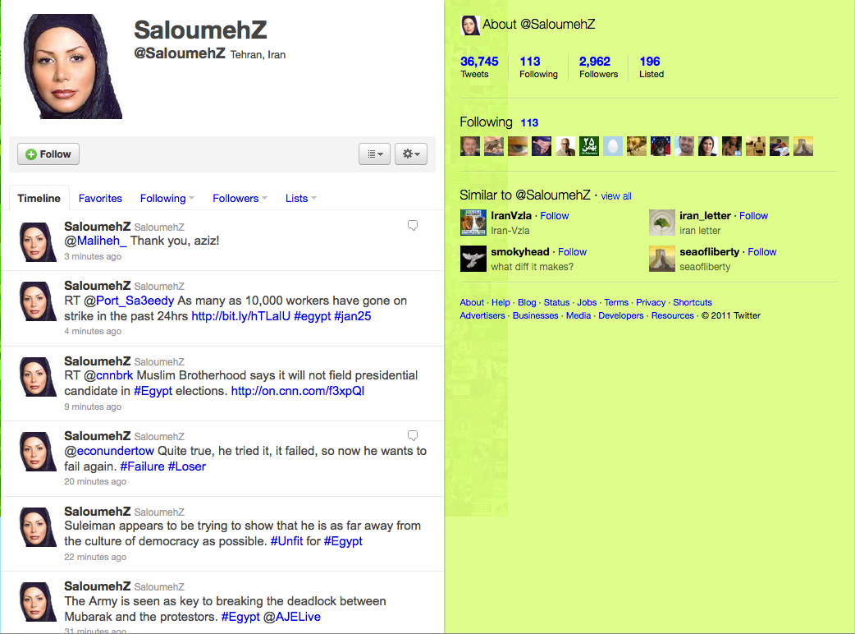
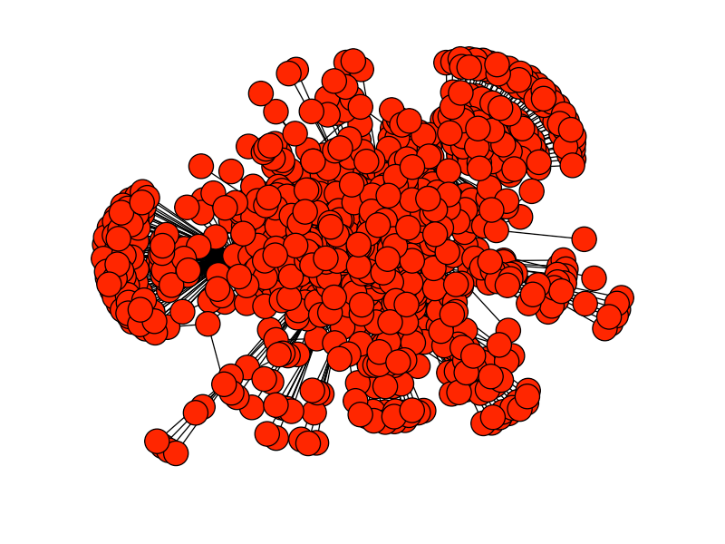
SaloumehZ
UNCLASSIFIED
Twitter Followers: 2,692
Reactions Generated: 990
Reactions per 1K followers: 334
UNCLASSIFIED
23

Slide 31
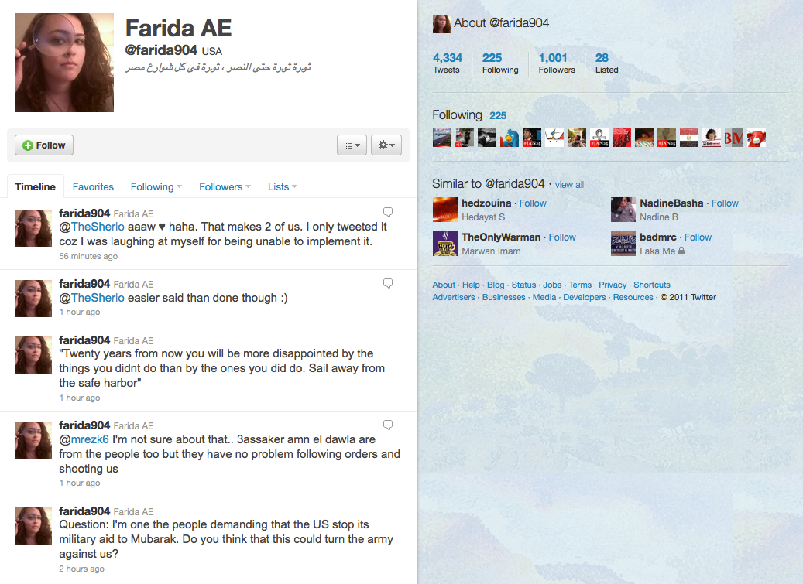
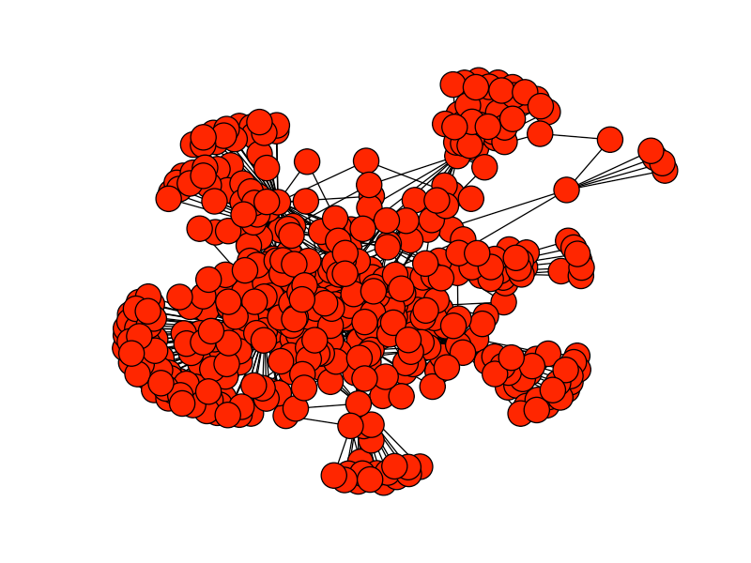
Farida AE
UNCLASSIFIED
Twitter Followers: 1,001
Reactions Generated: 507
Reactions per 1K followers: 506
UNCLASSIFIED
24

Slide 32
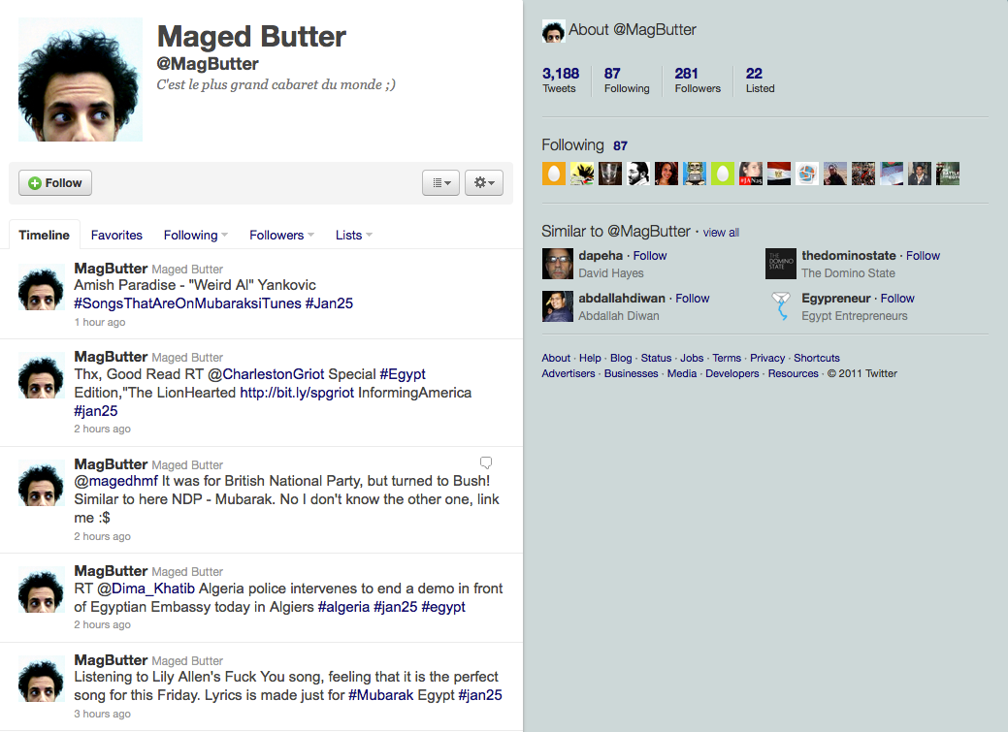
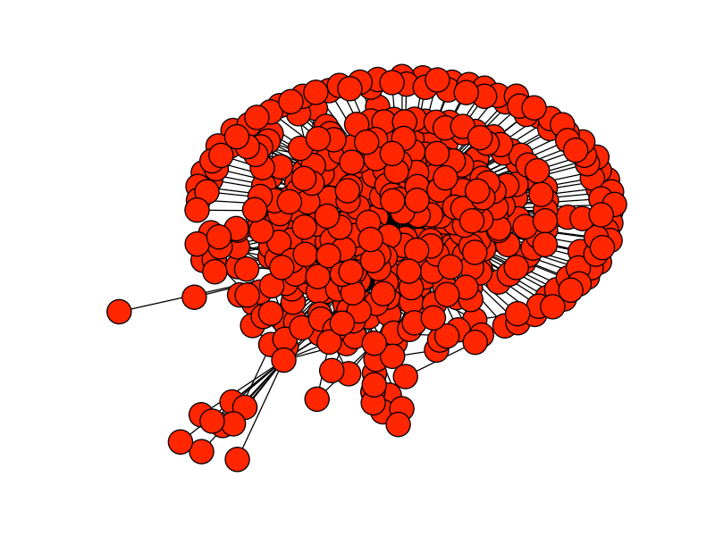
Maged Butter
UNCLASSIFIED
Twitter Followers: 281
Reactions Generated: 487
Reactions per 1K followers: 1,733
UNCLASSIFIED
25

Slide 33
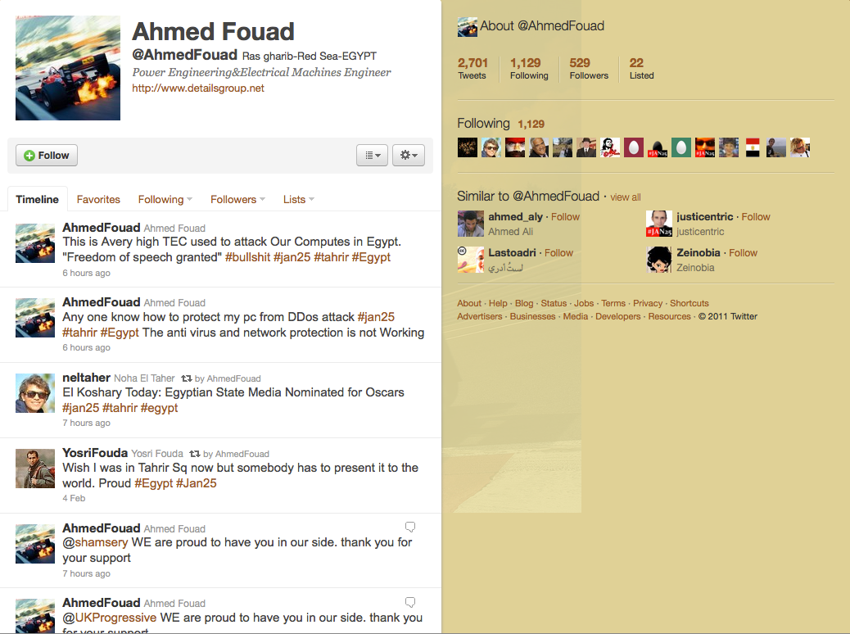
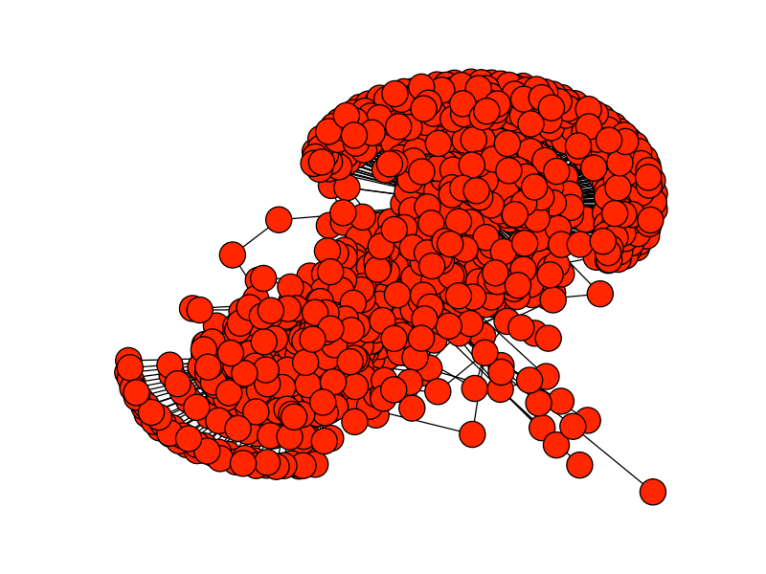
Ahmed Fouad
UNCLASSIFIED
Twitter Followers: 529
Reactions Generated: 1,229
Reactions per 1K followers: 2,323
UNCLASSIFIED
26

Slide 34
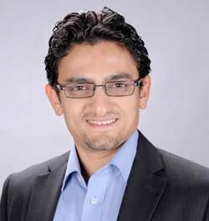
You say you want a revolution …
UNCLASSIFIED
Wael Ghonim
Twitter Followers: 86,000+
Reactions Generated: 3,291
Reactions per 1K followers: 38
UNCLASSIFIED
27

Slide 35
How do we do this?

Slide 36

DeepMile uses Agent209, a proprietary
social influence tool to identify, activate and
measure influencers
Identify
Activate
Measure
Gather massive amounts of data from postings, comments, and tweets in real-time (or any other web/enterprise data source).
Identify relevant Mass Influencers
Engage Mass Influencers through:
Information Operations
(government)
Marketing Campaign (commercial)
Grassroots Activation (political)
Measure the impact of the campaign – engagement, sales, sentiment, conversion, donations, etc..
Measure message cascades, diffusion, volume and correlate to offline events
UNCLASSIFIED
9

Slide 37









Looking Up the Magician’s Sleeve
UNCLASSIFIED
Continuous Data Collection – Entire “Twitterverse” and other Targeted Social Media (Blogosphere, etc.)
UNCLASSIFIED
30

Slide 38
Continuous Collection
Wide-Shallow
3-5% of
EVERYTHING
Narrow-Deep
100% of narrow slices

Slide 39
What do we have?
~ 500 million tweets, wide-shallow
Up to 12 months of history in wide-shallow
3-5 million tweets a day, deep-narrow (for short periods of time)
~50 million user profiles (30% of active Twitter users)

Slide 40

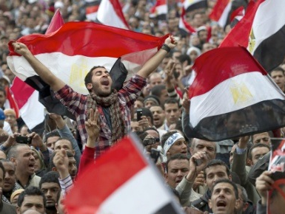

Agent 209
Social out-reachers
Where conversations occur
Provide targeted content
Drive to action
But there are millions of conversations!
29

Slide 41
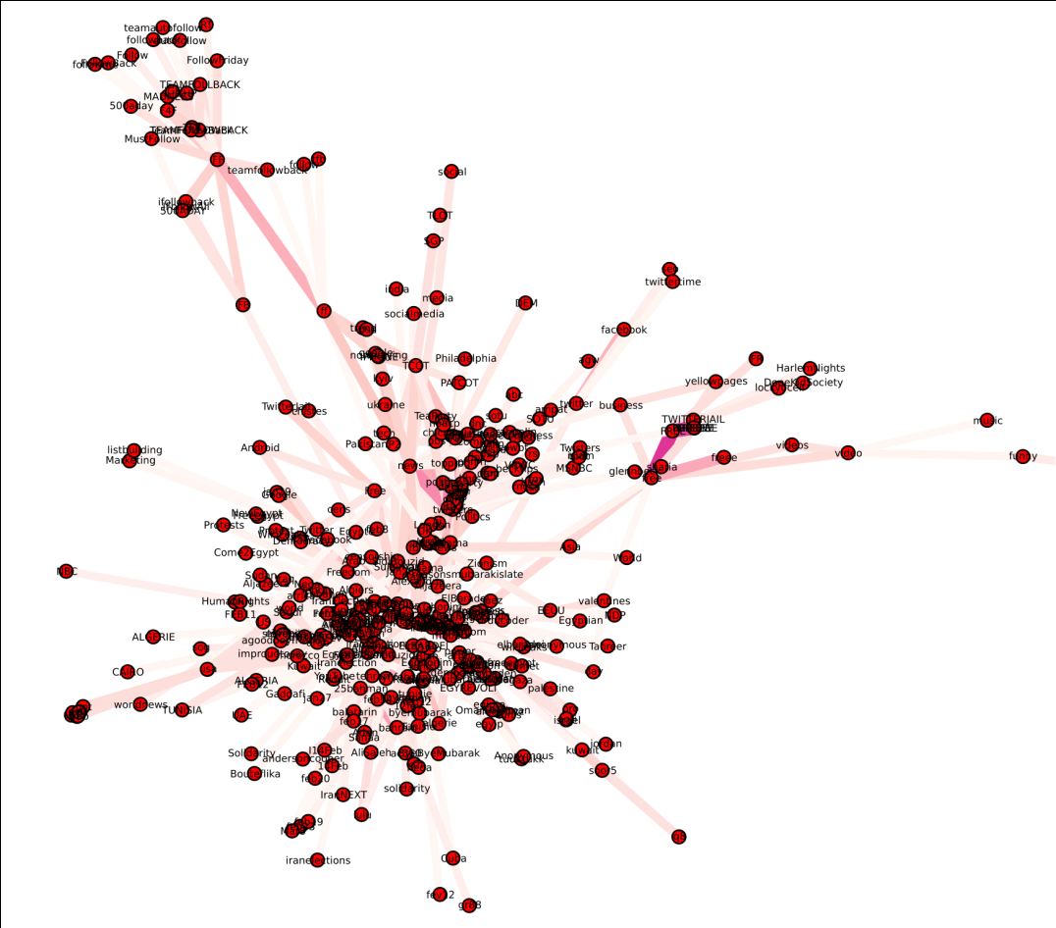
Map conversation topics and their relationships to each other – extracting only relevant conversations
31

Slide 42
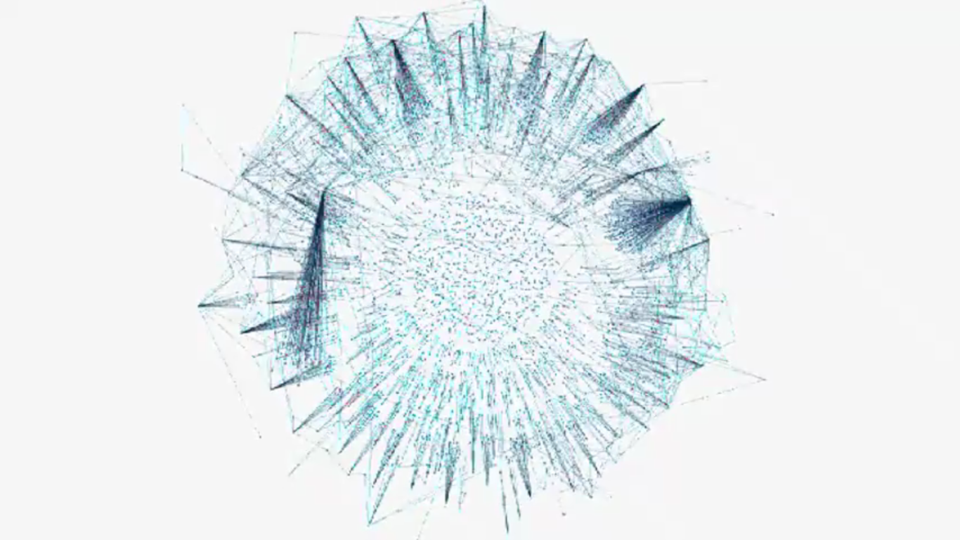
Looking Up the Magician’s Sleeve
Map information diffusion – processes – spread of ideas – influence
33

Slide 43
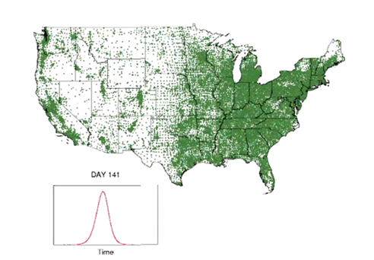
Looking Up the Magician’s Sleeve
Advanced geo-location of tweets and correlation to in-market events and news

Slide 44
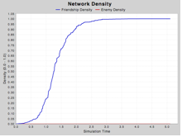
Diffusion Curves

Slide 45
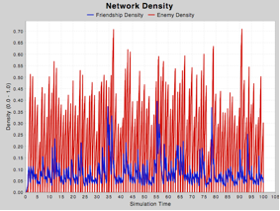
Diffusion of Hashtags

Slide 46
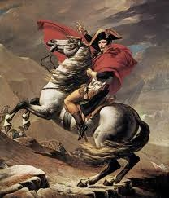
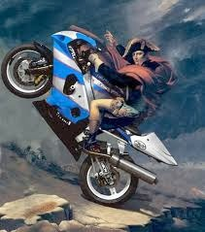
“There are but two powers in the world, the sword and the mind. In the long run the sword will always be beaten by the mind.”
- Napoleon Bonaparte

